Slide 1
APUSH Review: Key Concept 2.2
Period 2: 1607- 1754
Everything You Need To Know About Key Concept 2.2 To Succeed In APUSH
Updated for the 2015 revisions

Slide 2
The New Curriculum
Key Concept 2.2 “The British colonies participated in political, cultural, and economic exchanges with Great Britain that encouraged both stronger bonds with Britain and resistance to Britain’s control.”
Page 33 of the Curriculum Framework
Big ideas:
How did the colonists begin to develop an identity during this time?
What impact did religion have on the colonies?
Why did slavery develop in the British colonies? How did Africans resist their conditions?
This screams change and continuity!

Slide 3
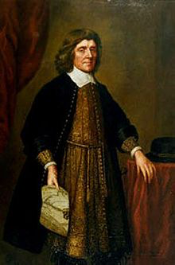
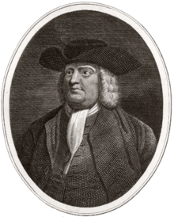
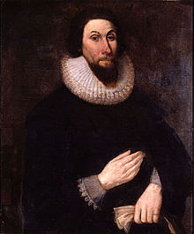
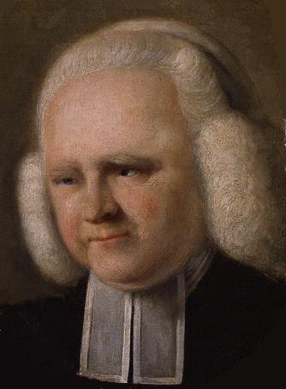
Key Concept 2.2, I
“Transatlantic commercial, religious, philosophical, and political exchanges led residents of the British colonies to evolve in their political and cultural attitudes as they became increasingly tied to Britain and one another.” - Page 33of the Curriculum Framework
A) Diverse religious and ethnic groups (Catholics, Quakers, Puritans, etc.) led to….
Pluralism – multiple groups existing together
Intellectual exchange from different European groups
Which were strengthened by:
1st Great Awakening – (Edwards and Whitefield – led to increase in conversions, new branches of Christianity)
Enlightenment – questioning of government (Locke – natural rights, Montesquieu – separation of powers)

Slide 4
Key Concept 2.2, I
B) How did the British colonies experience Anglicization (using more English norms and customs) over time?
Colonial governments were based on English models
Frequent contact with Britain via trans-Atlantic print culture – spread of ideas, and goods via trade and newspapers
Spread of Protestant Evangelicalism – George Whitefield, from England, and others traveled across the colonies to spread his message
C) The British sought to increase control of its colonies through its pursuit of mercantilism
Conflicts with colonists and Natives led to erratic (inconsistent) enforcement
Britain sought to limit colonial expansion to limit conflict with Natives (especially post 7 Years’ War – 1763)
Navigation Acts – required colonists to export specific goods only to England or English colonies – tobacco
Led to widespread smuggling from colonial merchants
Dominion of New England – combined Massachusetts with the rest of New England, and later New Jersey and New York
Assemblies were eliminated and a new governor was appointed – Sir Edmund Andros who was very unpopular

Slide 5
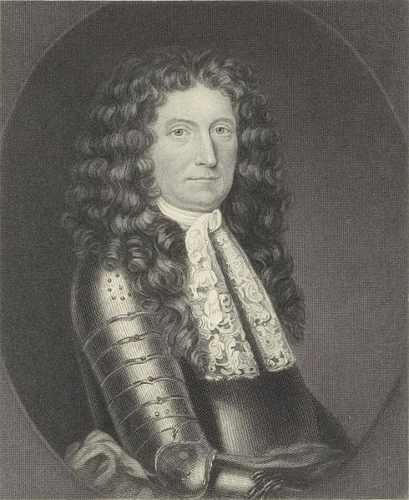
Key Concept 2.2, I
D) Colonial resistance to the British stemmed from:
Colonial self-government – Colonists (white, land-owning men in most cases) were able to vote for colonial representatives; had no say in Parliament
Ideas of liberty – Colonists saw themselves as British and wanted the same rights
Enlightenment – Challenged traditional ideas of government, encouraged limiting the power of government
Religious independence and diversity – 1st Great Awakening challenged traditional church authority; led to challenging authority in other areas (government(
Perceived corruption in the imperial system
Corrupt rulers like Sir Edmond Andros of the Dominion of New England; he eliminated colonial assemblies

Slide 6
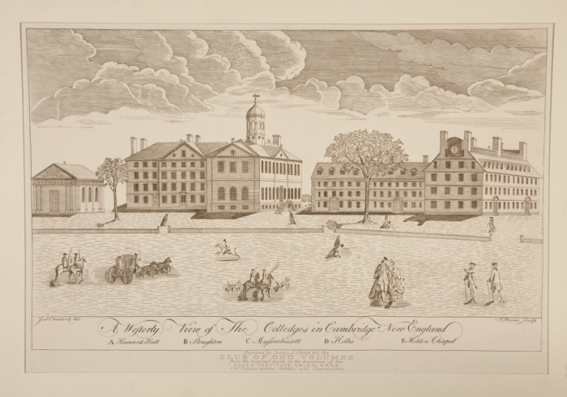
Key Concept 2.2, II
“Like other European empires in the Americas that participated in the Atlantic slave trade, the English colonies developed a system of slavery that reflected the specific economic, demographic, and geographic characteristics of those colonies.” - Page 34 of the Curriculum Framework
A) Why did all the British colonies participate in the slave trade to some degree?
Large amounts of land
High demand in Europe for colonial goods, particularly tobacco
Shortage of indentured servants, especially post-Bacon’s Rebellion
Where was slavery found in the British colonies?
Small farms in New England had some slaves
Port cities in the north and south
Plantations in the Chesapeake (MD and VA) and the South (NC, SC, GA)
Most African slaves were sent to the Caribbean

Slide 7
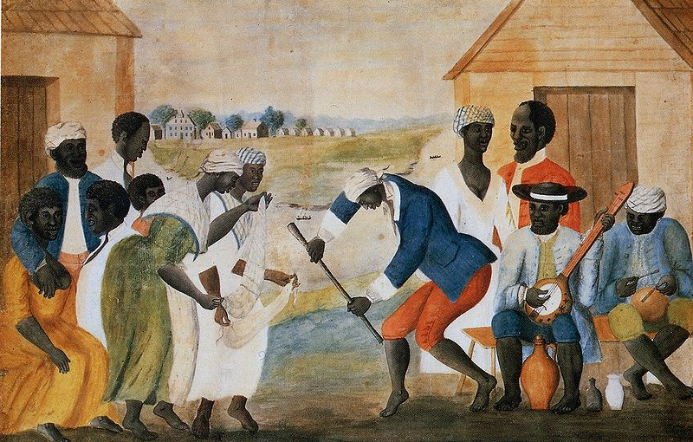
Key Concept 2.2, II
B) Impact of slavery in the south?
Emergence of a strict, racial system
Prohibition of interracial relationships (again, contrast with Spanish colonies)
Children of mothers that were slaves were enslaved (didn’t matter who the father was)
C) Africans resisted slavery and sought to maintain some levels of autonomy (family, culture, religion) How did Africans resist slavery?
Overtly – through rebellion (Stono Rebellion, 1739)
Covertly – breaking tools, running away, working slowly
How did Africans maintain some levels of autonomy?
Family – surrogate families for slaves that were sold
Culture – language and music
Religion – Combined elements of African religions with Christianity

Slide 8
Test Tips
Multiple-Choice and Short Answer Questions:
Impact of the Enlightenment and the First Great Awakening
Goals of mercantilism and colonial economic goals
Growth of slavery
Essay Questions:
Reasons for the growth of slavery and its impact (including ways Africans resisted their plight)
Change and continuity of British imperial control and relations with colonies

Slide 9
Short Answer Question
Remember, each part (a, b, c) must be AT LEAST 2-3 sentences.
The late 17th and early 18th centuries saw a rise in African slave labor in the British colonies.
A) Briefly explain one reason for the rise of African slavery in the British colonies.
B) Briefly explain one impact for the rise of African slavery in the British colonies on Africans.
C) Briefly explain one way African slaves resisted slavery.

Slide 10
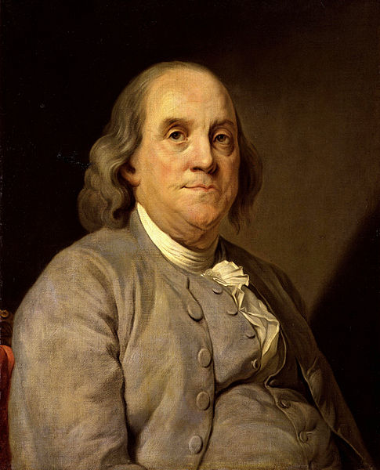
See You Back Here For Key Concept 3.1!
Thanks for watching
Please subscribe and share
Check out APUSHReview.com for many more resuources

